Slide 1
Middle School Week Two
Notes:
Orange Frog Comic Book - https://www.orangefrogschools.com/middle-school/ofcomicbook

Slide 2
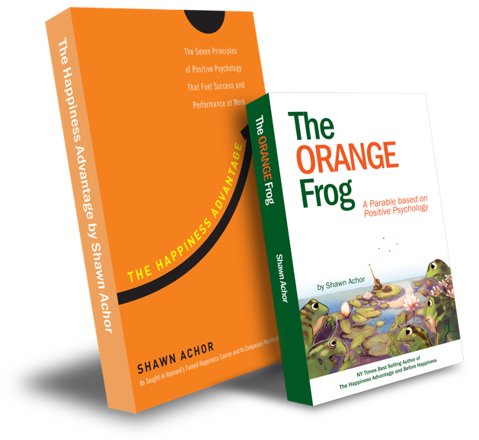
The Happiness Advantage
and
The Orange Frog
By Shawn Achor

Slide 3
The Orange Frog
Learning Objective:
I can read/listen to the Orange Frog Comic
I will discuss the central theme of the Orange Frog and will discover connections for my everyday life
Notes:
Standard:
Essential Concept and/or Skill: Communicate and work productively with others emphasizing collaboration and cultural awareness to produce quality work.
Interact positively as a team member.
Cooperate with others in a group setting.
Generate ideas with group members.
Are active listeners.
Read and understand information in a variety of forms.
Express ideas.
Skill:
Active listening, express ideas
Allow Spark to read pages 13-18 for the students or read to them.
https://www.orangefrogschools.com/elementary/ofkidsbook

Slide 4
Skills
Interact positively as a team member.
Cooperate with others in a group setting.
Generate ideas with group members.
Are active listeners.
Read and understand information in a variety of forms.
Express ideas.

Slide 5


Thoughts
“We are going to talk about the choice to be Orange.
Spark knew that when he was green, he didn’t feel as good as being Orange. When he started taking better care of himself and being kind to others, he became more and more Orange.
What types of things can we do to become more Orange?

Slide 6
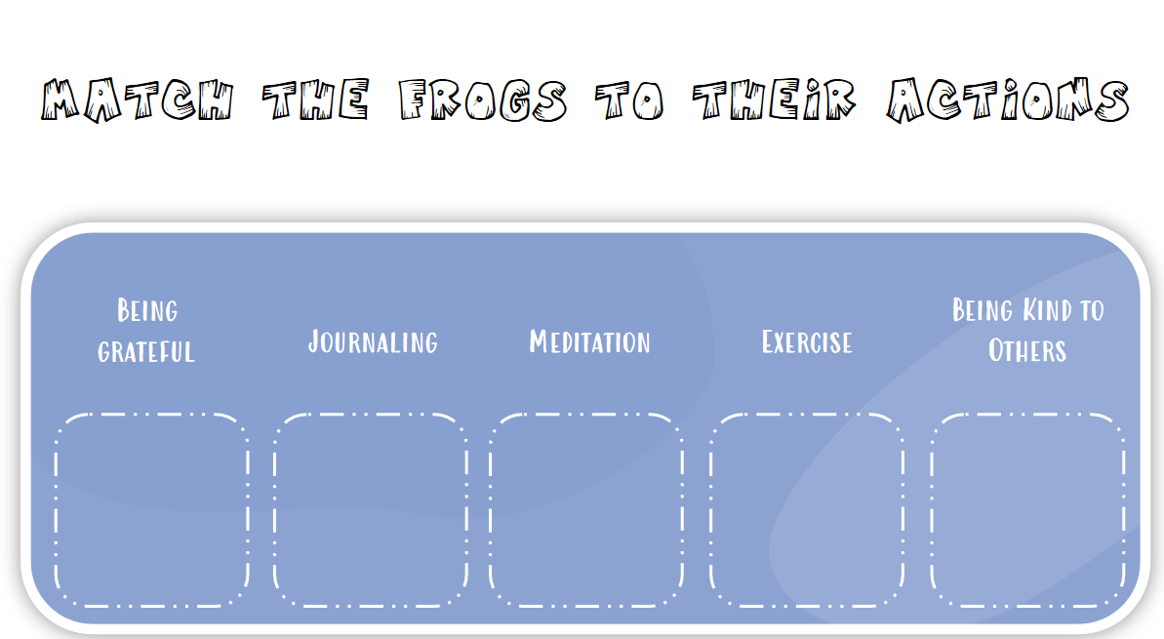




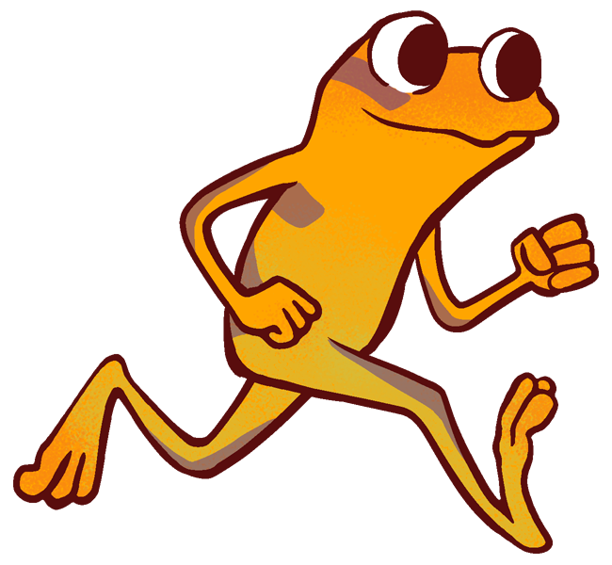
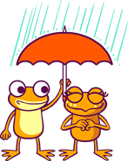
ACTIVITY
Notes:
You can either use this as a group activity and share on a projector or print out copies provided on the website for students to cut and paste the pictures on their own.

Slide 7
BONUS
What is each pond known for?
Which frog goes to which pond?
When do they expect the next Deluge?
What happens when Spark compliments Bull, and when he begins catching flies?

